Slide 1

Pipeline Parallel Systems for Big AI Models
Speaker: Shixiong Zhao
Supervisor: Prof. Heming Cui

Slide 2
Trends of Machine Learning (ML) models
Large models succeed in tasks including NLP, Computer Vision, …
Transformer based: BERT, Vision Transformer, GPT-2, GPT-3
Huge mount of parameters => training exceeds a single GPU's capacity
GPT-3 175 billion parameters
CPM-Large 10+ billion parameters
GPT-2 workaround for Chinese
Complex architectures => expedites Exploratory and Dynamic training
E.g., Neural Architecture Search => Evolved Transformer
E.g., One-shot Pruning and Training
DNN Architectures may vary in minute level
Bring challenges to existing parallel training systems

Slide 3
Revisit DNN Training
Batch-based and Iterative data processing:
Forward Pass: compute loss and produces activations
Backward Pass: back-propagate loss, produces gradient and consumes activations
Optimizer Step: update parameters according to history and produced gradient
GPU memory consumption
Model Parameters (increase with model size)
Scratch space for computation (Transient usage, released immediately)
Activations (up to 70-80%, increase with batch size)

Slide 4
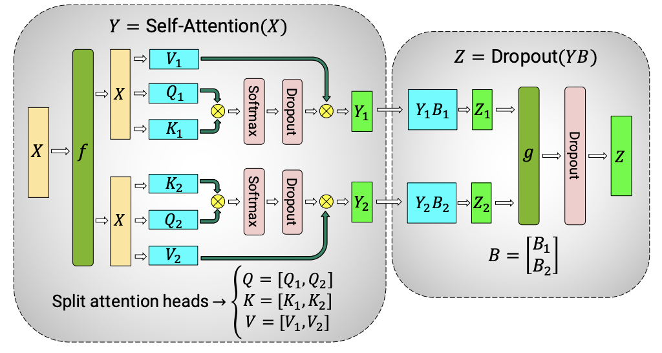
Parallel Training
Parallel Training becomes a MUST
Accelerate training with more GPUs
Support larger DNNs that cannot be trained by a single GPU
Modern parallel training systems – 3D parallelism
Data parallelism
Replicate model across GPUs, processing batches in parallel, all-reduce gradients
Major bottleneck: large communication volume (2 x parameter size)
(Intra-Layer) Model parallelism
Usually applied when a single layer cannot fit in a single GPU, split a layer across GPUs
Major bottleneck: large communication volume (sync of activations)
Pipeline parallelism
Pipeline (inter-layer) model parallelism
Benefit: communication friendly, one key dimension for training extremely large model

Slide 5
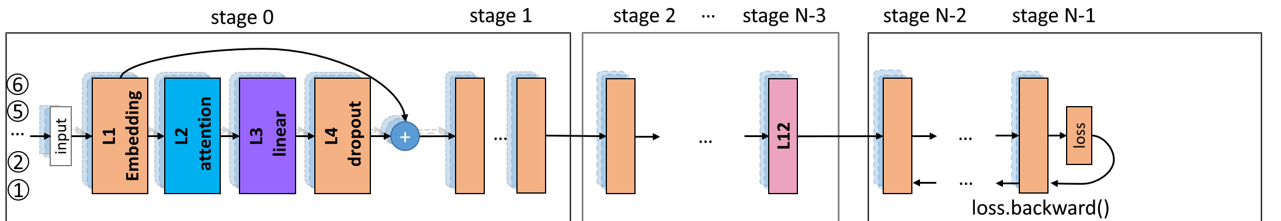
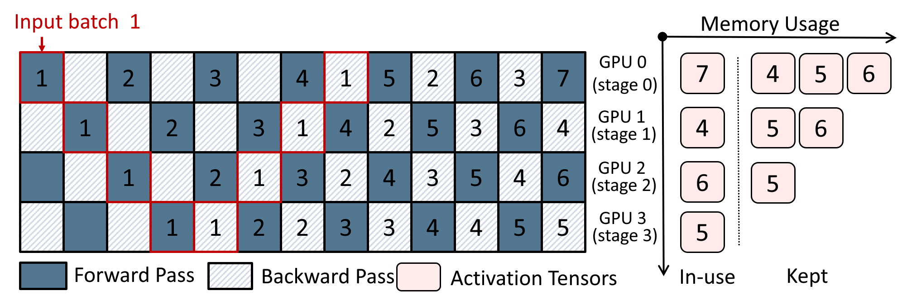
Pipeline Parallelism
Split a model's layer across GPUs, and inject multiple data batch to form a pipeline
GPU 0
GPU 1
GPU 2
GPU N-3
GPU N-2
GPU N-1
Host 0
Host 1
…
GPU 0
GPU 1
GPU 2
GPU 3

Slide 6
VPipe: our Pipeline Parallel Training System
Published in IEEE TPDS 2021
Authors: Shixiong Zhao, Fanxin Li, Xusheng Chen, Xiuxian Guan, Jianyu Jiang, Dong Huang, Yuhao Qing, Sen Wang, Peng Wang, Gong Zhang, Cheng Li, Ping Luo, Heming Cui
Achieved cutting-edge training throughput on big models (e.g., BERT)
2x throughput v.s. Pipedream (Microsoft, SOSP '19)
1.3x throughput v.s. GPipe (Google, NeurIPS '19)
Support extremely dynamic training processes (e.g., Evolved Transformer)
4x throughput compared with Pipedream and Gpipe
3-D parallel training system platform in Huawei Cloud

Slide 7
Challenges for Pipeline Parallelism
Challenge 1: Imbalanced Memory Burden
Recall that -
Activations are the major memory consumption
Produced in Forward Pass and Consumed in Backward Pass

Slide 8
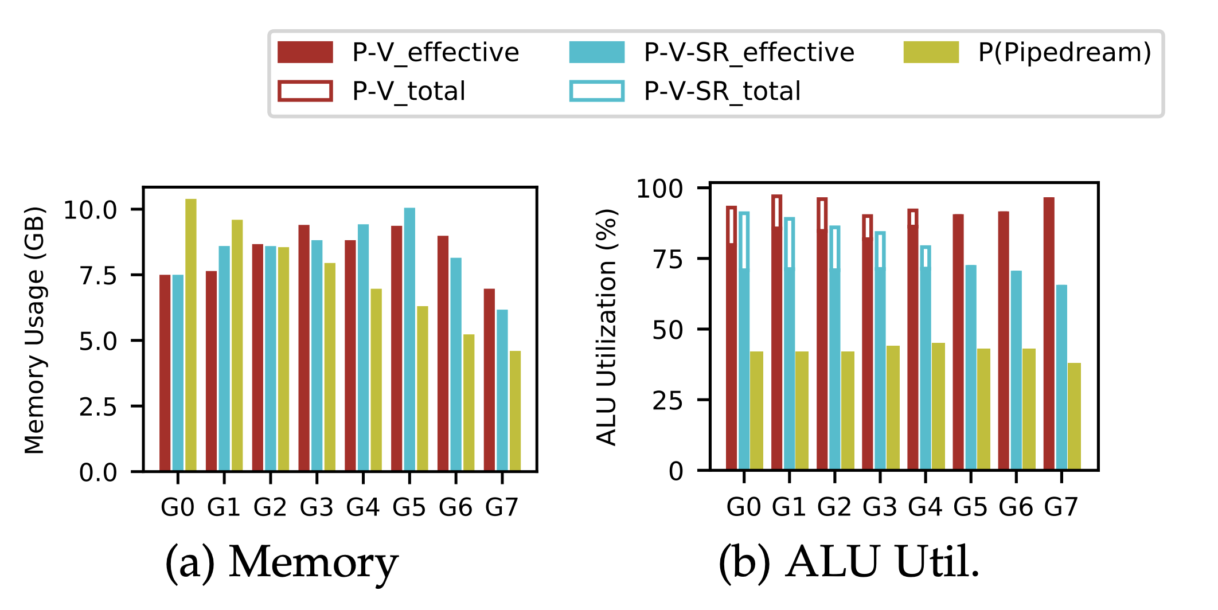
Challenges for Pipeline Parallelism
Challenge 1: Imbalanced Memory Burden
Problem caused:
The first GPU immediately reached limits
Limit the batch size when training large DNNs
Low batch size => Low GPU ALU utilization
GPU requires large enough batch size to use its hardware power

Slide 9
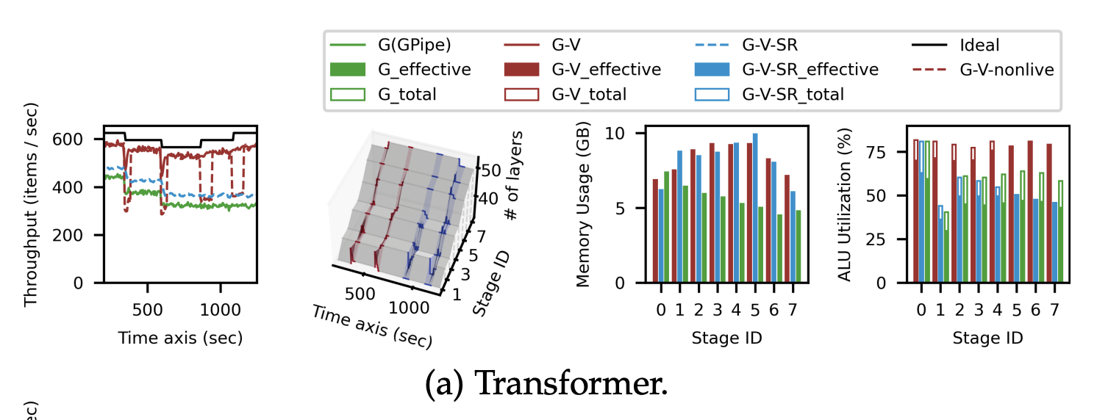
Challenges for Pipeline Parallelism
Challenges 2: Dynamic layer changing / parameter pruning when serving dynamic training processes
Problem caused:
Pipeline stage partition becomes imbalanced
Imbalanced stage partition => causes bubbles and lowers the throughput

Slide 10
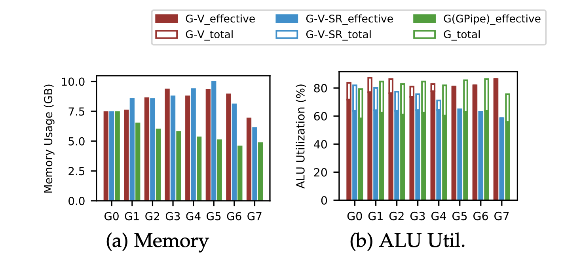
Existing systems
GPipe addresses challenge 1:
Drop activations in forward pass
Recompute all activations (i.e., perform another forward pass) in backward pass
Problem: all-recompute causes unnecessary overhead
Both Pipedream and GPipe neglects challenge 2:
Use static partition during whole training process

Slide 11
VPipe in a nutshell
Manage training Activations by incorporating intuitions from pipeline
Intuition 1: front stages have much heavier burden than the rear stages
A smart-recompute strategy: recompute more on front stages and recompute less on rear stages
Intuition 2: a time window exists between each forward and backward pass of each data batch
Swap activations to CPU and pre-fetch them back before backward pass
Dynamically adjust layer partitions according to real time execution statistics
VPipe firstly introduces a non-stop live layer migration protocol to enforce new partition plan

Slide 12
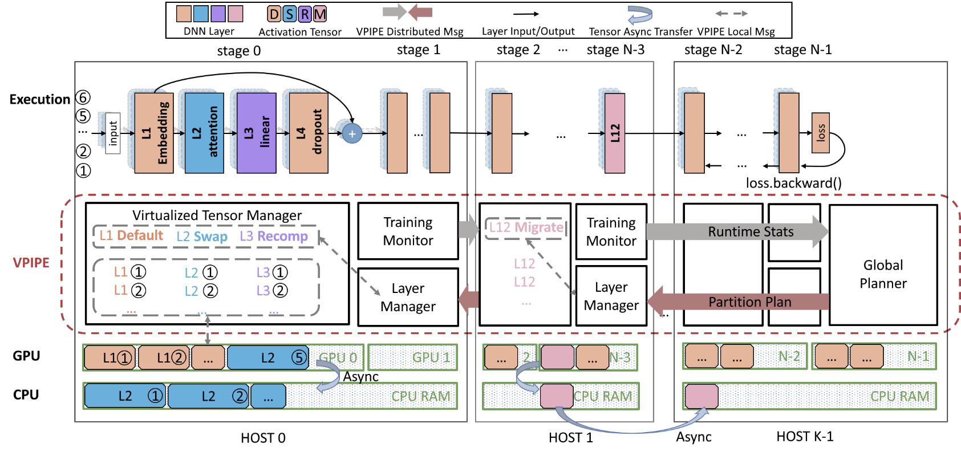
VPipe Architecture

Slide 13
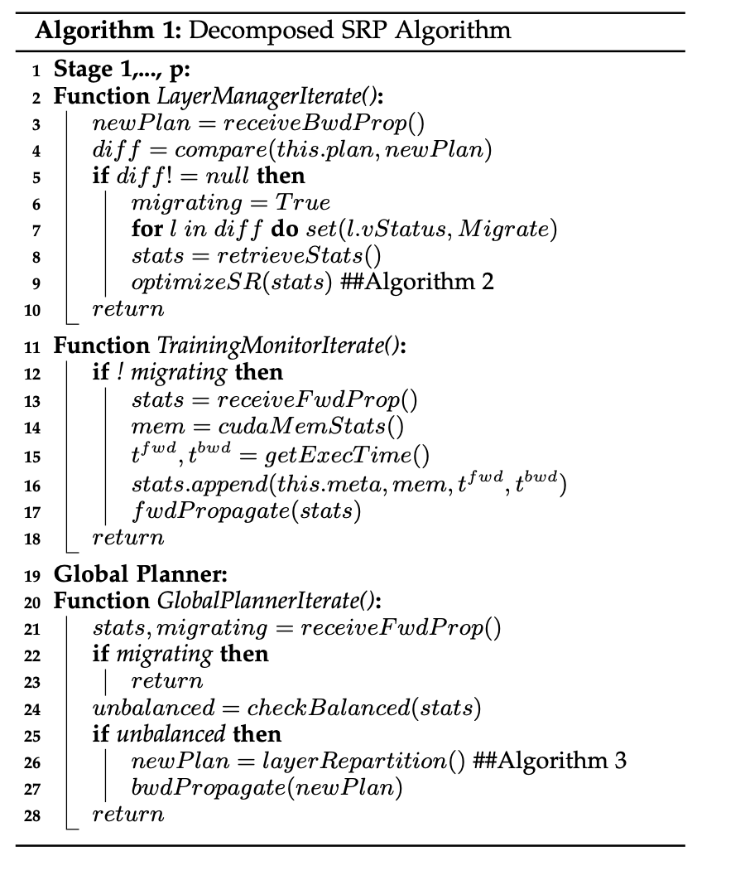
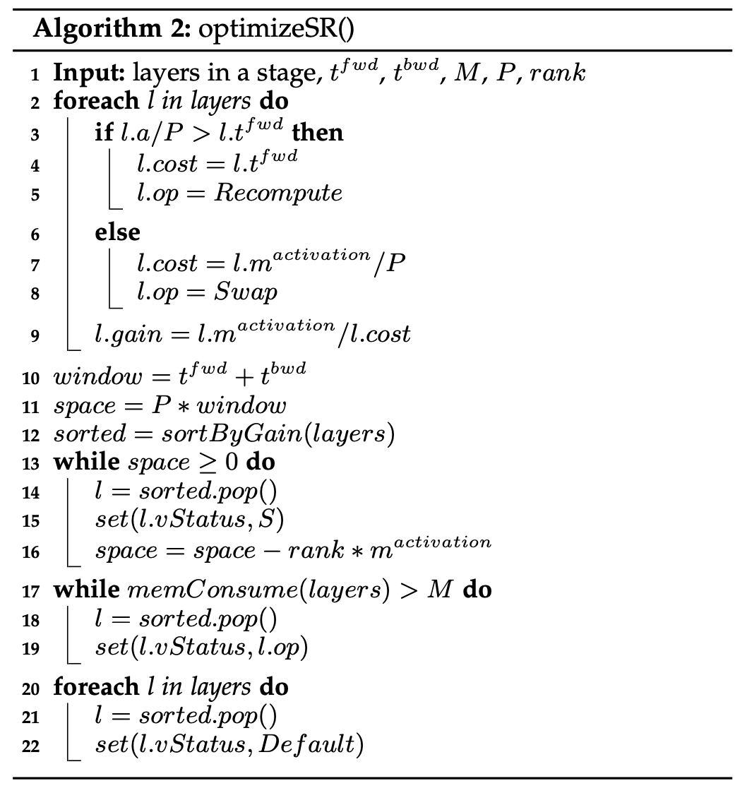
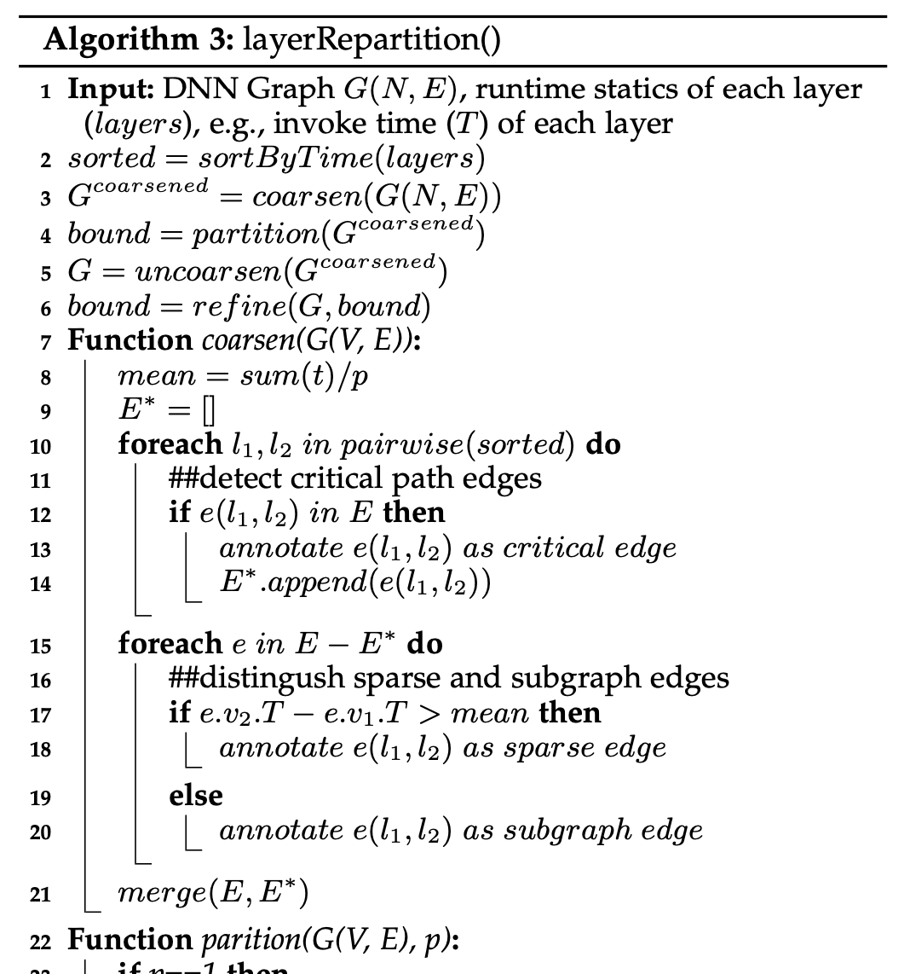
Swap, recompute, and partition forms a combinatorial optimization problem
NP-complete
VPipe solves it by decomposition and iteration

Slide 14
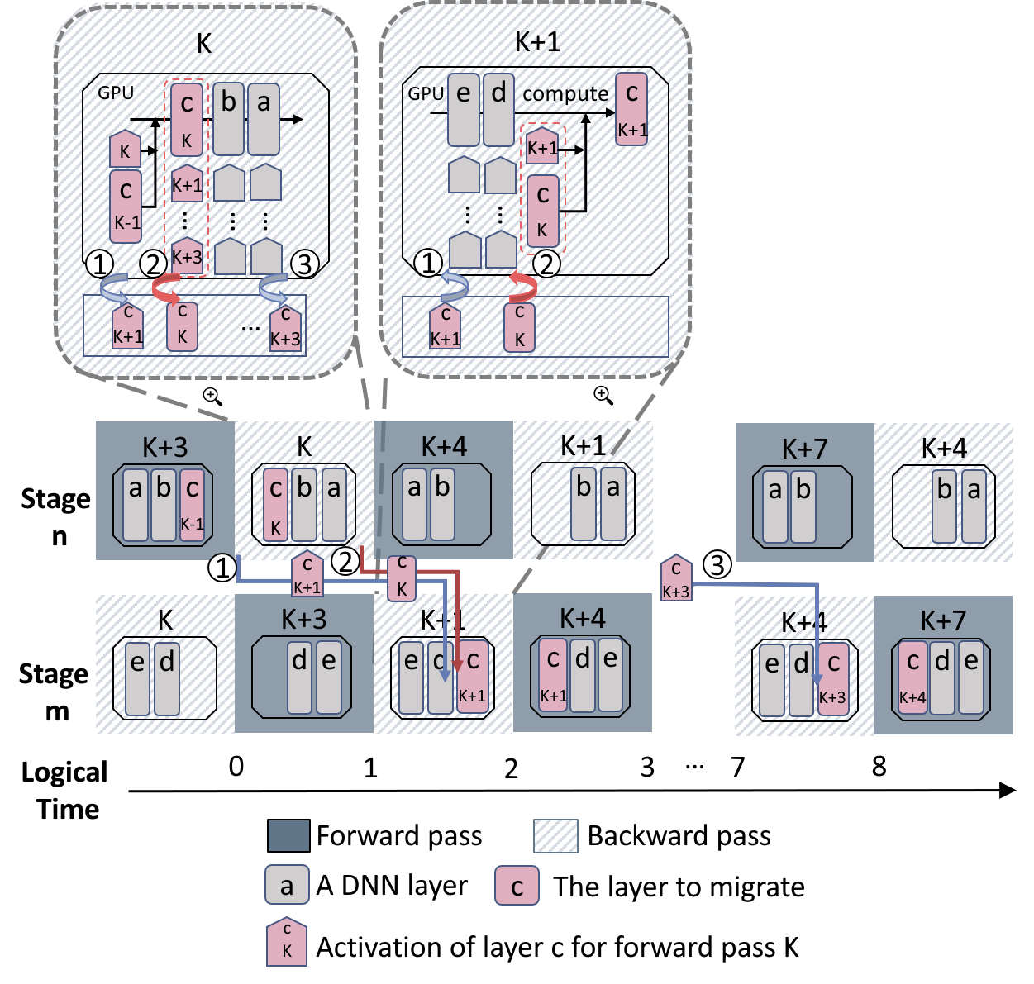
Non-stop layer migration protocol
Async activation migration by overlapping communication with computation
Strong barrier check to enforce correctness and transparency

Slide 15
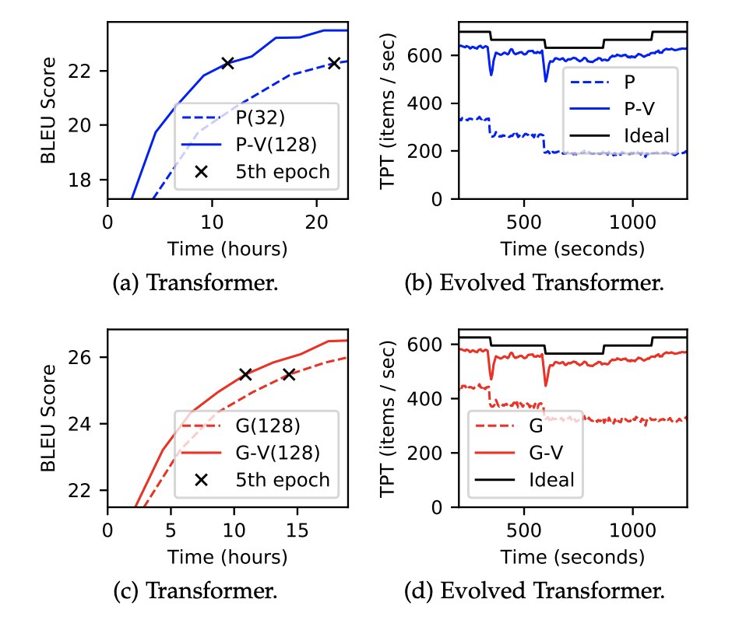
Evaluation Results
Large Model Training
E.g., Transformer
Dynamic Model Training
E.g., Evolved Transformer
More applications such as one-shot pruning
More detailed evaluations, refer to our paper

Slide 16
Evaluation Results
More detailed evaluations, refer to our paper

Slide 17
Extend VPipe to a system platform
Collaborating with Huawei
VPipe has already supported 3-D parallelism and in the process of tremendous optimizations
Trained a GPT-2 Large model on 32 V100 GPUs with cutting edge throughput
Use Data parallel, Intra-layer model parallel, and Pipeline parallel
Designing a new parallel training system for extreme dynamic training processes
One-shot neural architecture search
One-shot pruning and training
Fast, Reusable and Adaptive Compiler for Training and Inference
Communication optimization for GPU-GPU collective communication libraries (NCCL)
More on Transformer
Neural Architecture Search in one-shot
Mixture-of-Expert Transformer

